Slide 1

AI-Based Freelance-Startup System Progress Presentation
Week 03

Slide 2

01 Project Positioning
02 Weekly Progress
03 Planning and Next Steps
Contents
CATALOGUE

Slide 3


01 Project Positioning

Slide 4
Current Phase
C
Phase 1: Intelligent Foundation
Focus: System Design and Core Architecture
Goal of Week 03: Start Implementing
C
Phase Tasks:
AI Recommendation Tool (Candidate Match)
Data Coherence AI
AI Predictive Tool
Selection and Mission Update
Mission Deployment
Application Tracking System
Profile Engineering

Slide 5
Weekly Objective
01
Deploy PostgreSQL Infrastructure
deploy PostgreSQL using Docker to establish a stable, containerized relational database environment.
02
Schemas and Service Integration
connect each schema to its corresponding microservice.
02
Develop Core Backend Features
implement selected core functionalities within the connected microservices to initiate real business logic execution.

Slide 6

02 Weekly Progress

Slide 7
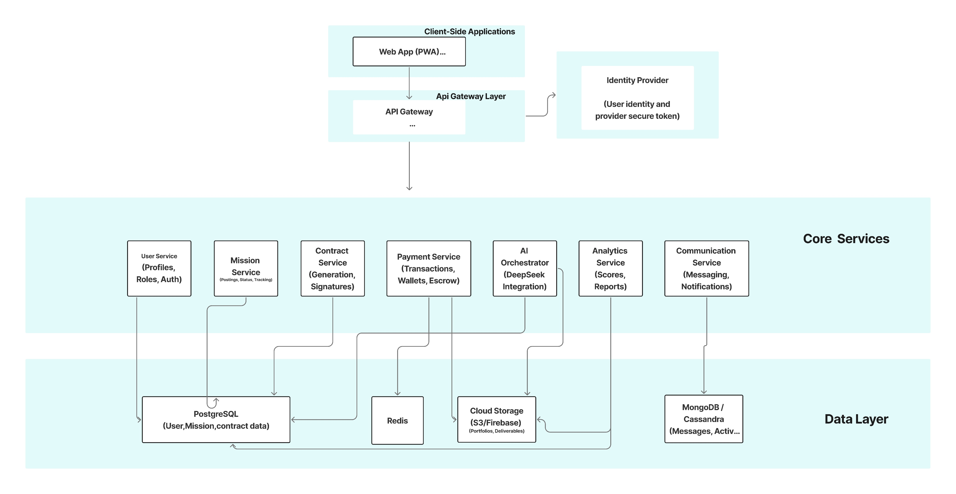
Work Completed This Week

Slide 8

Work Completed This Week
Concerned Microservices
Concerned Databases

Slide 9
Work Completed This Week
DataBases Deployment
Databases Deployed
PostgreSQL – Relational database for structured data
Redis – In-memory data store for caching, messaging, and event streaming
MongoDB – NoSQL database for flexible storage of unstructured data
Deployment Highlights
Containerized using Docker for isolated and reproducible environments
Configured connections to microservices ensuring data accessibility and independence

Slide 10
Work Completed This Week
Mission Service
Objective
Developing the final Selection Function to officially assign a freelancer and update the mission status globally.
Developing the Publish Mission functionality, allowing startups to define requirements such as (Title, Description, Skills, Budget, and Duration).
Infrastructure SetupDeployment
Data Isolation
Schema Design and Data Integrity
Robust Mission Publishing
API Functional
Event Producer

Slide 11
Work Completed This Week
Analytics Service
Objective
Implementing a real-time status tracker for freelancers to monitor their application journey (Pending, Viewed, Shortlisted, Accepted, Rejected).
Service Initial Development
Database Testing (local)
API Documentation and Testing
Initial Admin Dashboard Analysis
Container Testing

Slide 12
Work Completed This Week
User Service
Objective
Creating and managing detailed Startup Profiles, including
startup information and mission statistics to build professional credibility.
Creating and managing detailed Freelancer Profiles, including
freelancer information and skills.
Infrastructure SetupDeployment
Data Isolation
Schema Design and Data Integrity
Database Integration (postgres)

Slide 13
Work Completed This Week
Data Coherence Tool
Objective
AI to ensure the coherence and consistency of information: Using AI to validate data integrity.
Skill NormalizationStandardizes
IT Role Detection
Seniority Estimation
Technology Stack Classificatio
Contradiction and Data Risk Detection
Global Quality Score

Slide 14
Work Completed This Week
AI Recommendation Tool (Candidate Match)
Objective
Developing an AI engine to analyze mission requirements and recommend the most compatible freelancers (Mission Microservice).
LLM integration for AI reasoning and tool execution
Tool-based architecture for mission search and compatibility analysis
API endpoints for testing and interaction

Slide 15

03 Planning and Next steps

Slide 16
Plan for the Next Week
Complete the Objectives of Each Service
01
Ensure all microservices (Mission, Analytics, AI Orchestrator, etc.) fully implement their planned functionalities for Phase 1.
Improve the Objectives of Each Tool
02
Improve and test tools (Profile Analyzer, AI Recommendation modules) to meet functional requirements.
Integrate Frontend with Backend
03
Connect the frontend interface to the backend services for all features developed in this phase, enabling end-to-end functionality.

Slide 17

Thank you

